Slide 1
PROTECTING Fitbit data under local differential privacy
Thomas Marchioro

Slide 2
Lifelogging datasets
Participant | Age | Gender | Height | Weight | Fitbit data
P1 | 48 | male | 195 | 100 | Time series
P2 | 60 | male | 180 | 90 | Time series
P3 | 25 | male | 184 | 82 | Time series
P4 | 26 | female | 163 | 58 | Time series
P5 | 35 | female | 179 | 69 | Time series
Date | Steps | Calories | Distance | Sleep
2019/11/01 | 17873 | 4009 | 12 | 8h 11min
2019/11/02 | 13118 | 3533 | 9 | 7h 35min
2019/11/03 | 4773 | 2785 | 2 | 4h 20min
2019/11/04 | 4761 | 1932 | 2 | 5h 13min
2019/11/05 | 14312 | 3748 | 7 | 9h 54min
… | … | … | … | …

Slide 3
Global anonymization/sanitization
Gather data from all the participants
Store them in a dataset
Apply anonymization/sanitization techniques to the data (apply k-anonymity, remove revealing attributes)
Problems:
Participants need to entrust their “clean” data to researchers
Many public datasets do not even anonymize the participants (LifeSnaps does!)

Slide 4





Local differential privacy
Participants send anonymous reports containing randomized data
$R^{(1)}=X^{(1)}+$ noise
$R^{(2)}=X^{(2)}+$ noise
$R^{(3)}=X^{(3)}+$ noise
Researcher

Slide 5
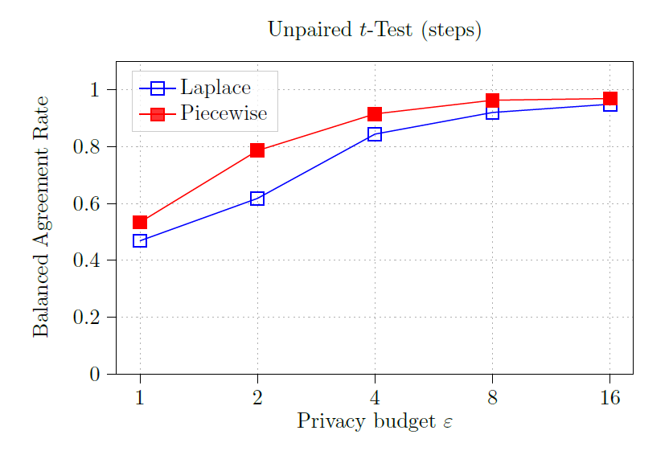
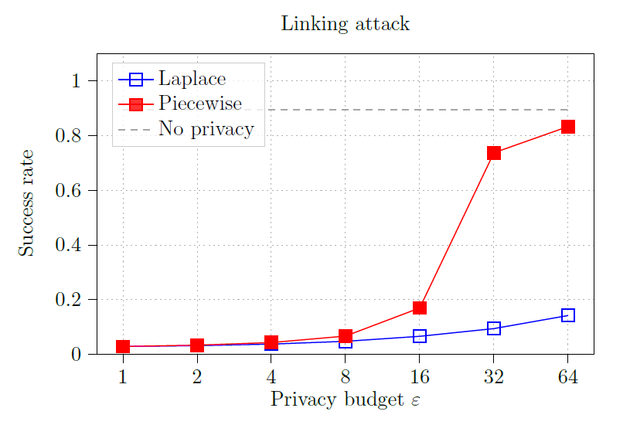
How much protection do we obtain?

Slide 6
Are the randomized data still usable?

Slide 7
Future work
Measure agreement rate on paired t-Test (e.g., participants before and after a diet)
Test private attribute inference (gender, height, weight)

Slide 8
THANK YOU!

